Slide 1
Claudio Sartori Department of Computer Science and Engineering claudio.sartori@unibo.it https://www.unibo.it/sitoweb/claudio.sartori/ slides © Pearsons – Fluency with Information Technology – Snyder – Ch.09
Informatics
Programming and using R

Slide 2
Introduction
RStudio allows the user to run R in a more user-friendly environment. It is open-source (i.e. free) and available at http://www.rstudio.com/
For R related tutorials and/or resources see the following links:
http://dss.princeton.edu/training/
http://libguides.princeton.edu/dss

Slide 3
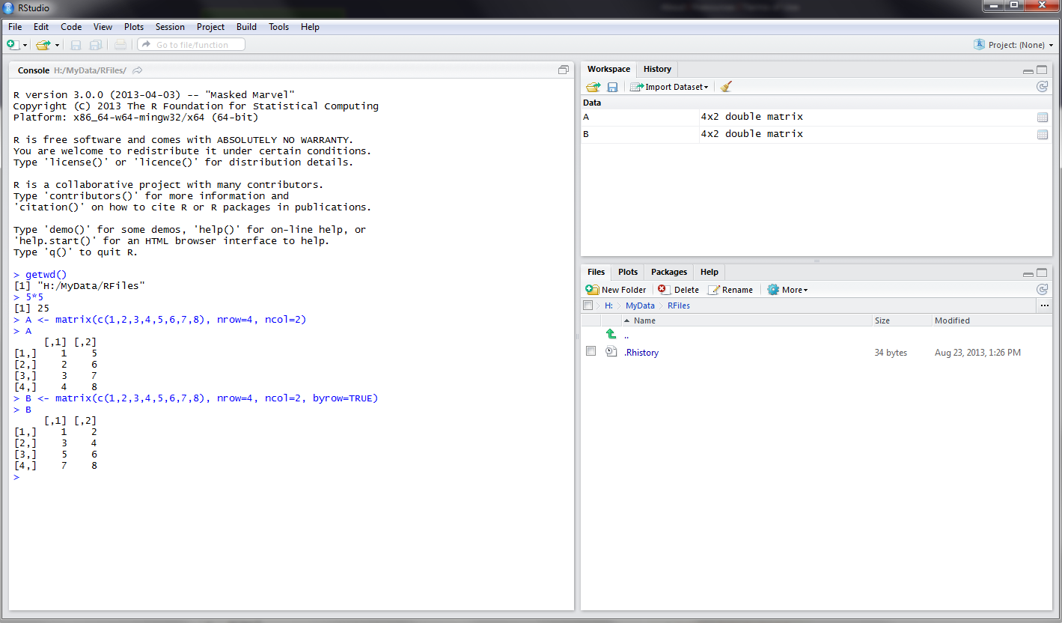
RStudio screen
The workspace tab shows all the active objects (see next slide). The history tab shows a list of commands used so far.
The files tab shows all the files and folders in your default workspace as if you were on a PC/Mac window. The plots tab will show all your graphs. The packages tab will list a series of packages or add-ons needed to run certain processes. For additional info see the help tab
The console is where you can type commands and see output

Slide 4
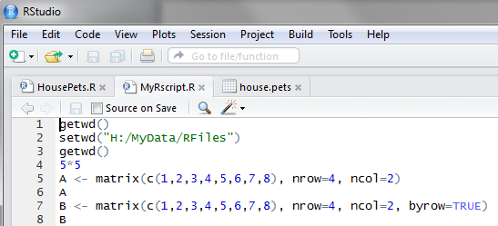
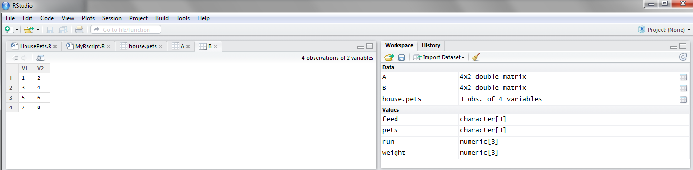
Workspace tab
The workspace tab stores any object, value, function or anything you create during your R session. In the example below, if you click on the dotted squares you can see the data on a screen to the left
Showing here matrix B. To see matrix A click on the respective tab.

Slide 5
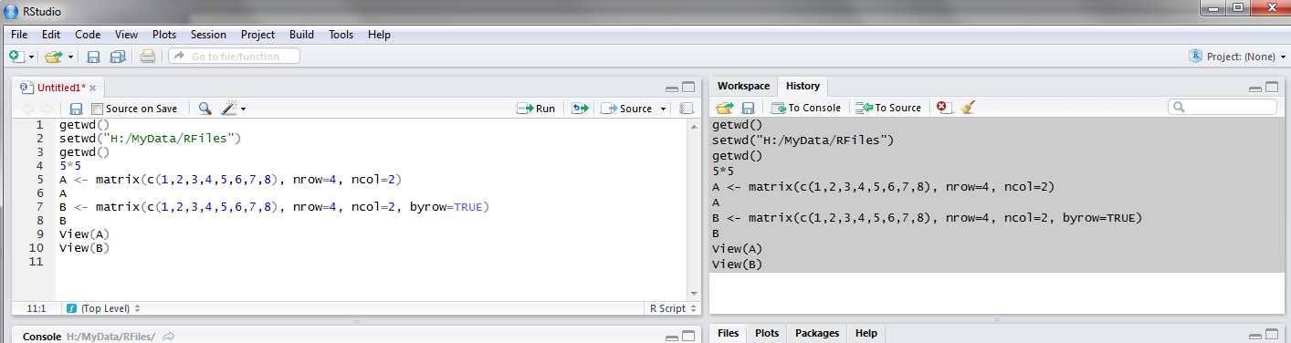
History tab
The history tab keeps a record of all previous commands. It helps when testing and running processes. Here you can either save the whole list or you can select the commands you want and send them to an R script to keep track of your work.
In this example, we select all and click on the “To Source” icon, a window on the left will open with the list of commands. Make sure to save the ‘untitled1’ file as an *.R script.

Slide 6
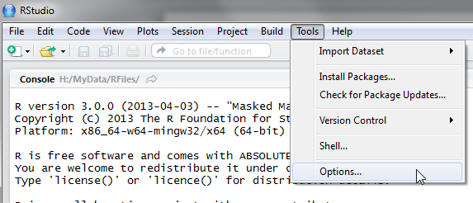
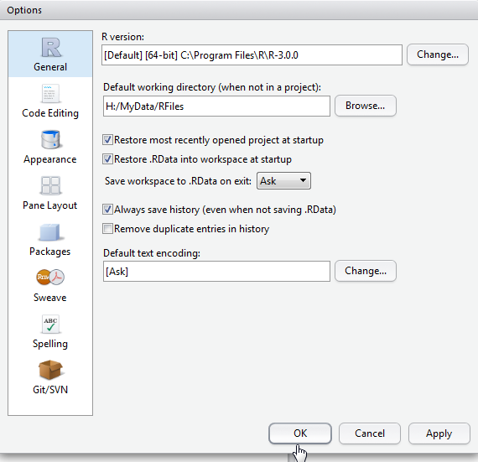
Setting a default working directory
Every time you open RStudio, it goes to a default directory. You can change the default to a folder where you have your datafiles so you do not have to do it every time. In the menu go to Tools -> Options

Slide 7
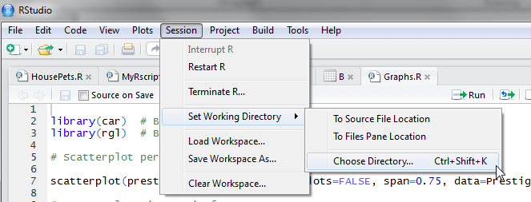
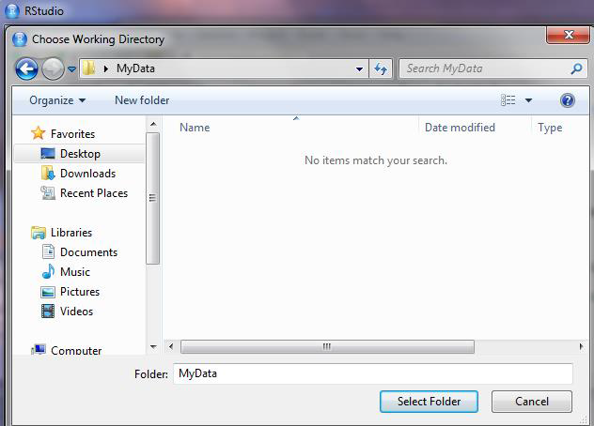
Changing the working directory
If you have different projects you can change the working directory for that session, see above. Or you can type:
# Shows the working directory (wd)
getwd()
# Changes the wd
setwd("C:/myfolder/data")

Slide 8
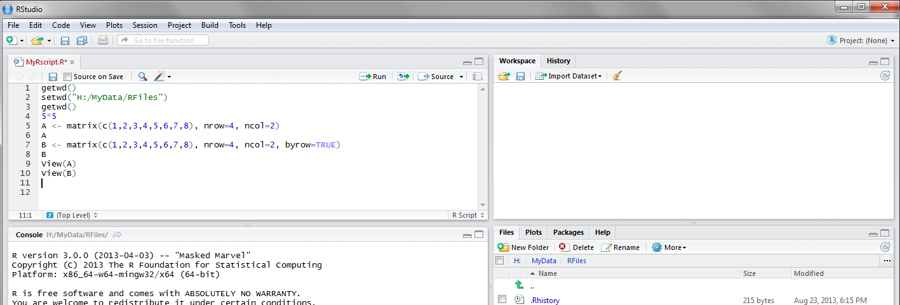
R Script (I)
The usual Rstudio screen has four windows:
Console.
Workspace and history.
Files, plots, packages and help.
The R script(s) and data view. The R script is where you keep a record of your work.

Slide 9
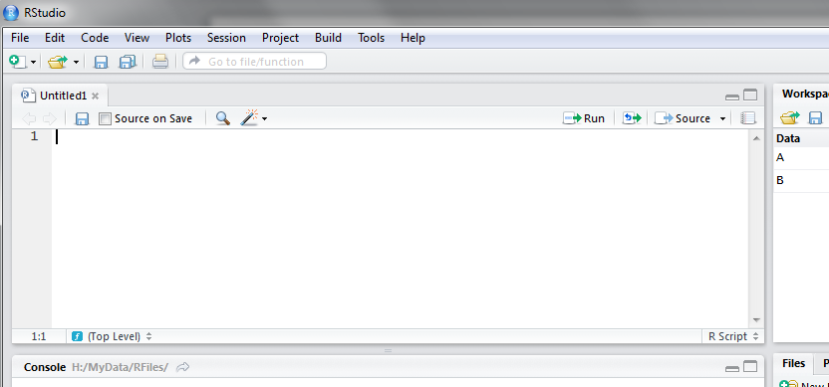
R Script (II)
To create a new R script you can either go to File -> New -> R Script, or click on the icon with the “+” sign and select “R Script”, or simply press Ctrl+Shift+N. Make sure to save the script.
Here you can type R commands and run them. Just leave the cursor anywhere on the line where the command is and press Ctrl-R or click on the ‘Run’ icon above. Output will appear in the console below.

Slide 10
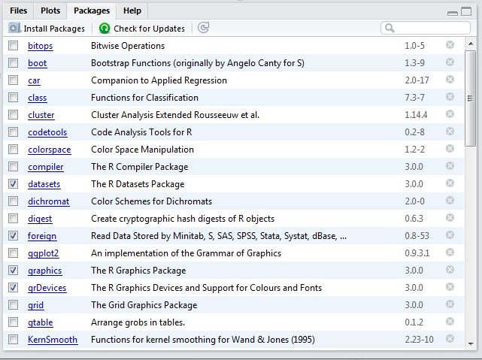
Packages tab
The package tab shows the list of add-ons included in the installation of RStudio. If checked, the package is loaded into R, if not, any command related to that package won’t work, you will need select it. You can also install other add-ons by clicking on the ‘Install Packages’ icon.
Another way to activate a package is by typing, for example, library(foreign). This will automatically check the --foreign package (it helps bring data from proprietary formats like Stata, SAS or SPSS).

Slide 11
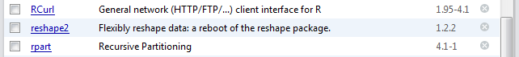
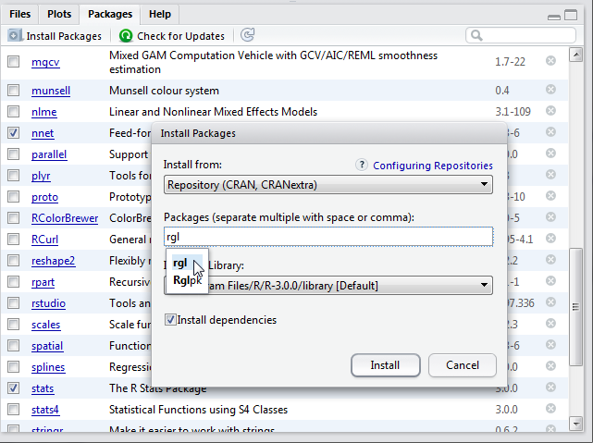
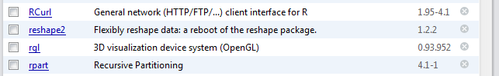
Installing a package
Before
We are going to install the package –rgl (useful to plot 3D images). It does not come with the original R install.
Click on “Install Packages”, write the name in the pop-up window and click on “Install”.
After

Slide 12
R Basics

Slide 13
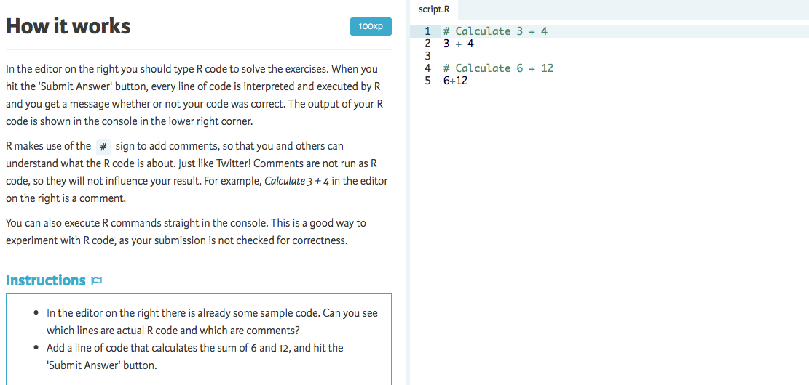

Slide 14
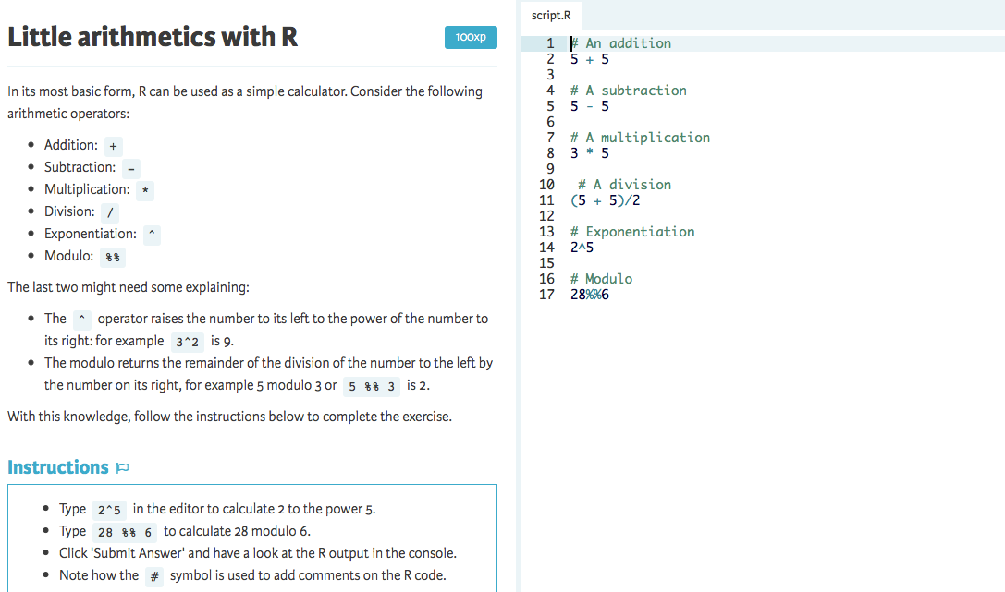

Slide 15
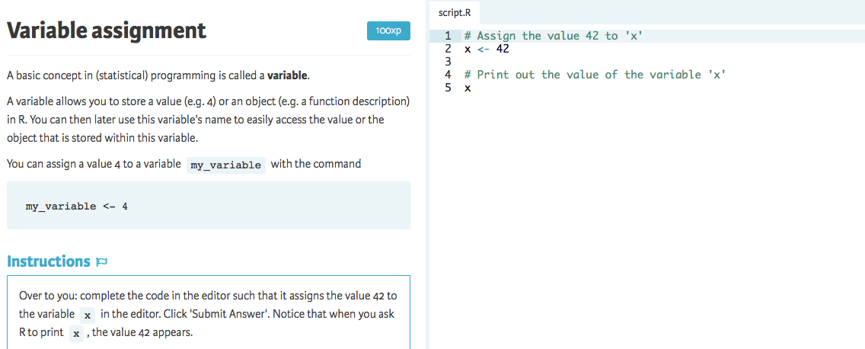

Slide 16
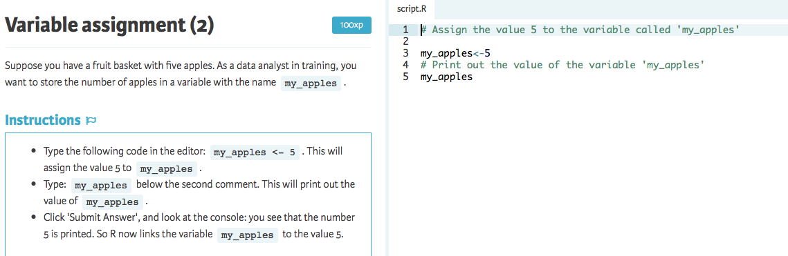

Slide 17
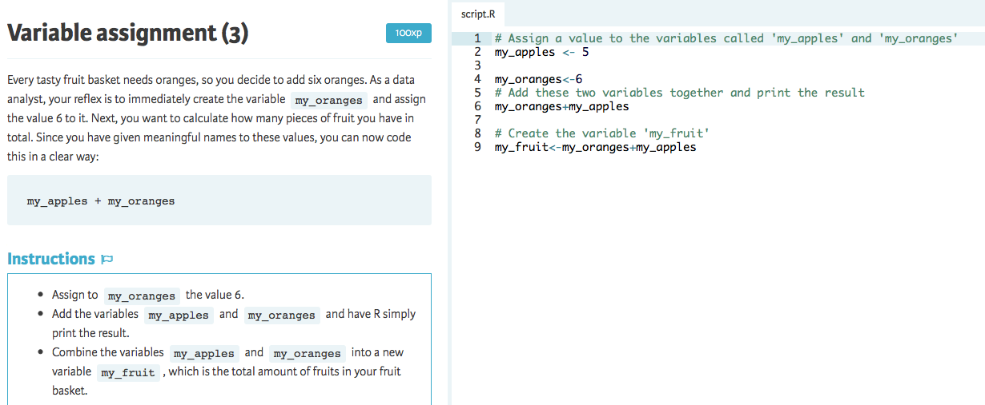

Slide 18
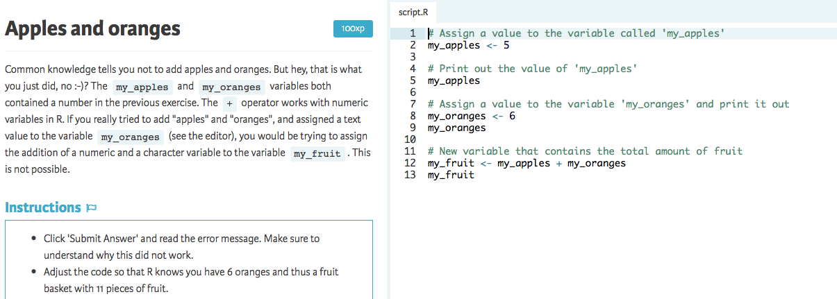

Slide 19
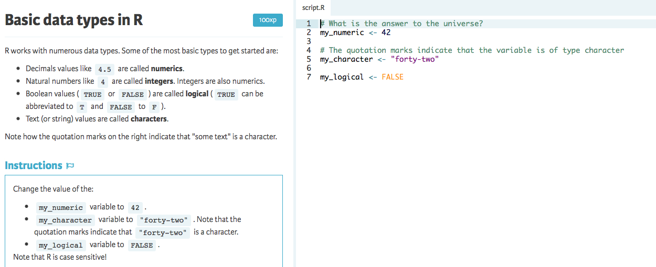

Slide 20
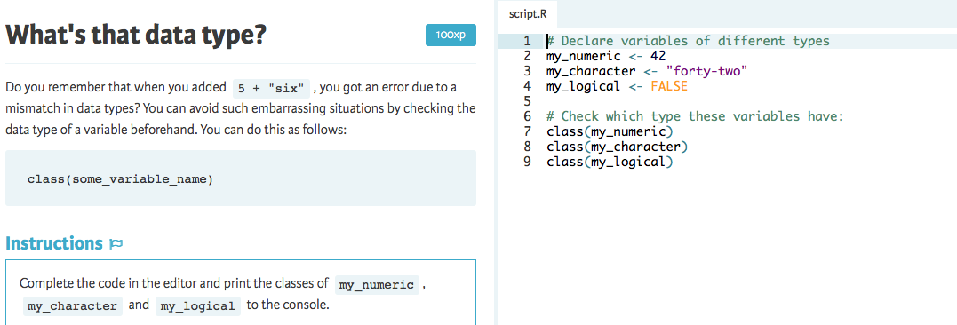

Slide 21
Vectors

Slide 22
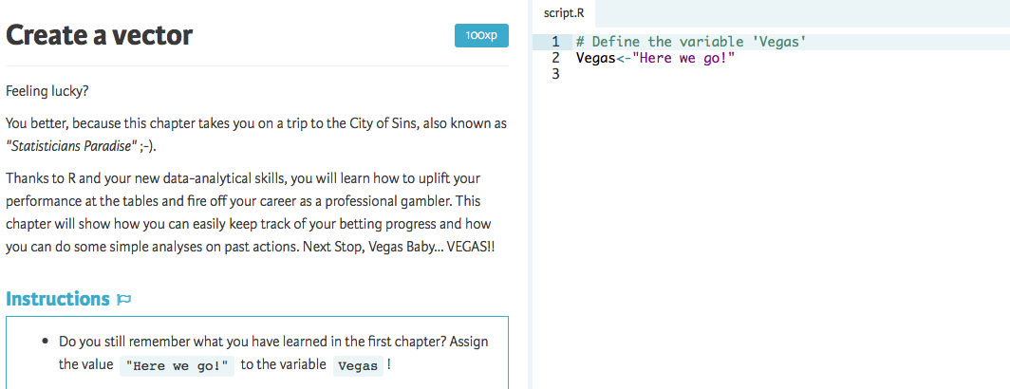

Slide 23
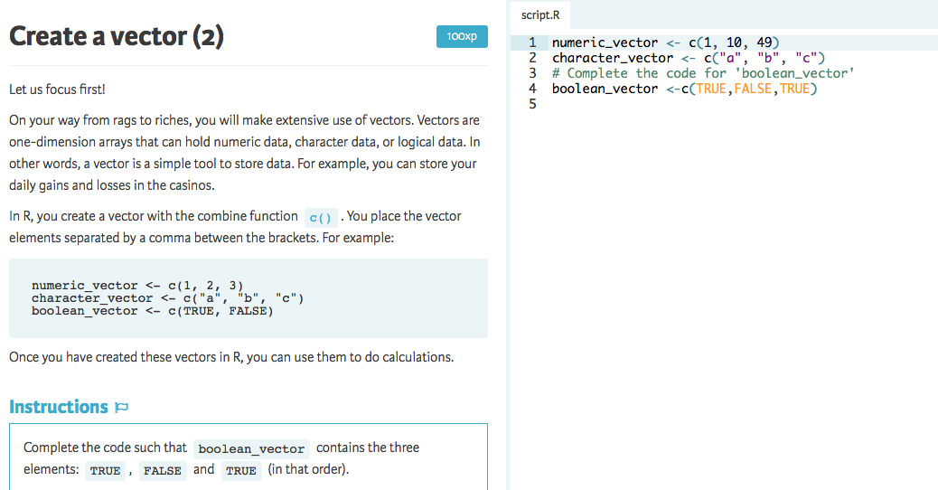

Slide 24
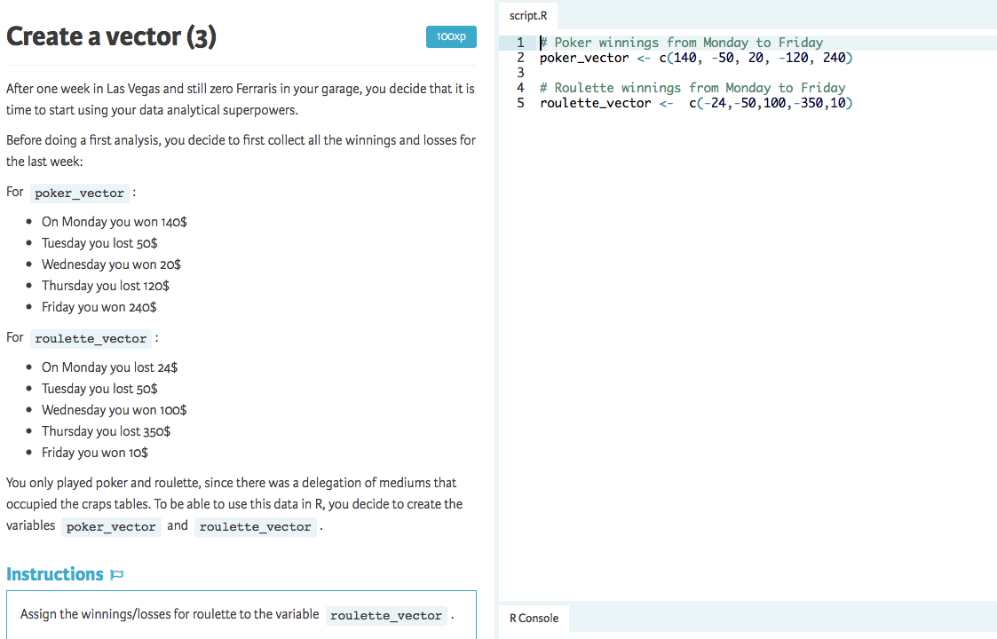

Slide 25
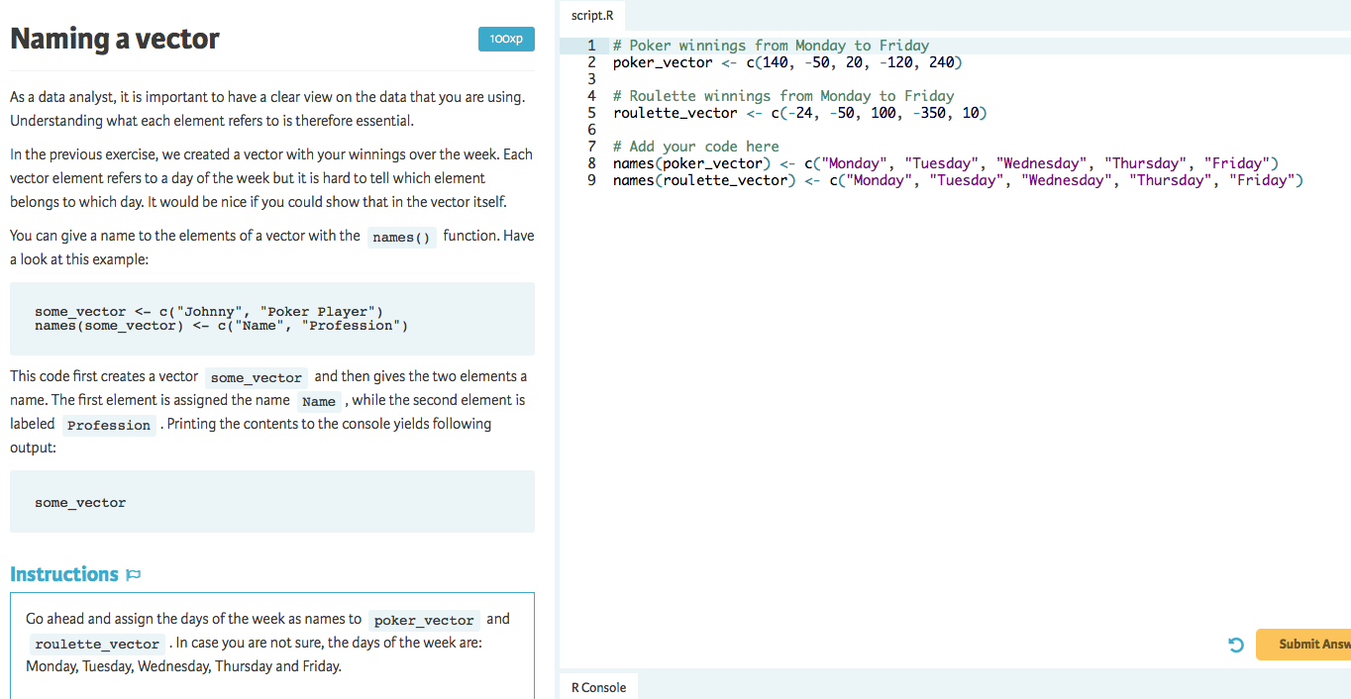

Slide 26
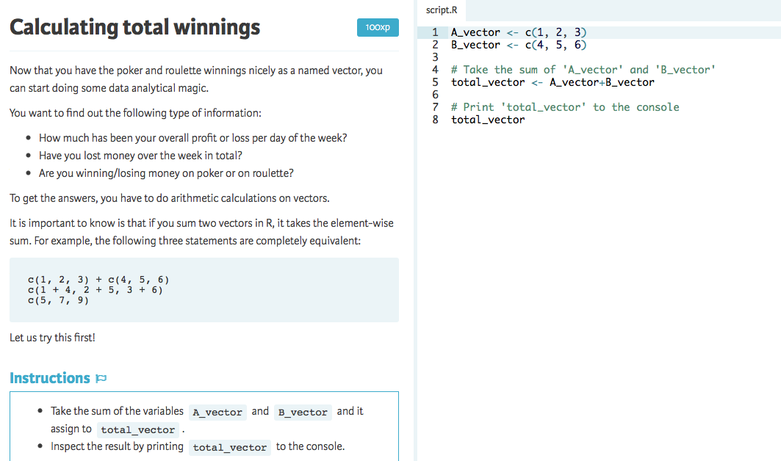

Slide 27
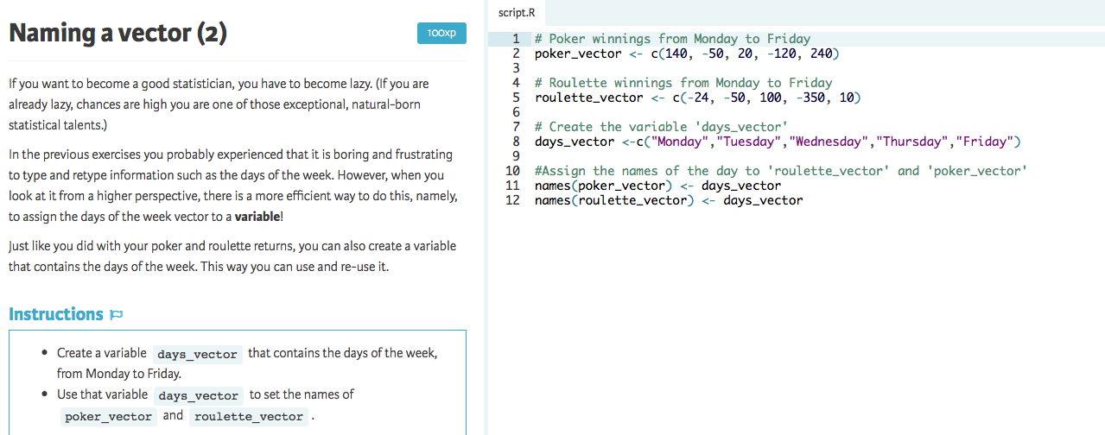

Slide 29
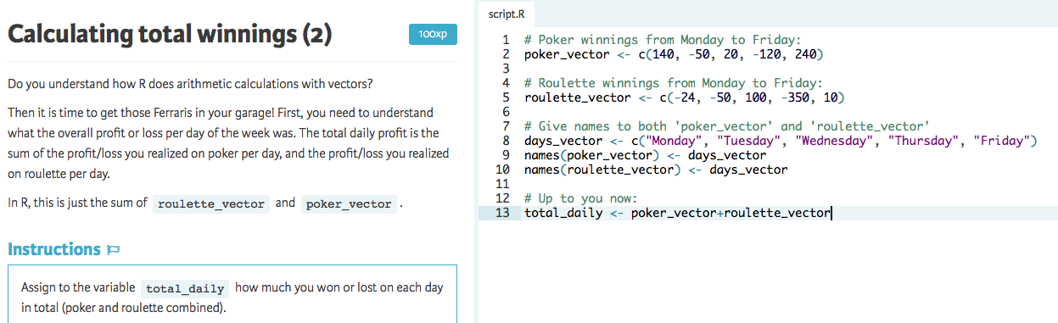

Slide 30
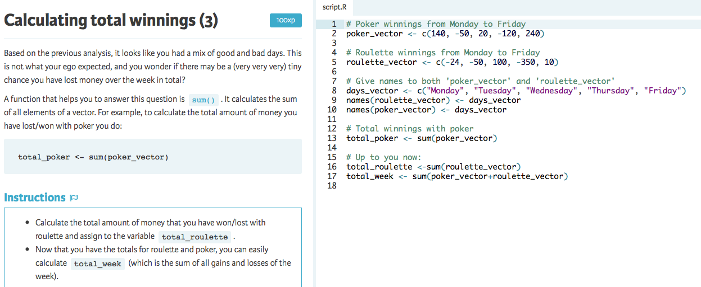

Slide 31
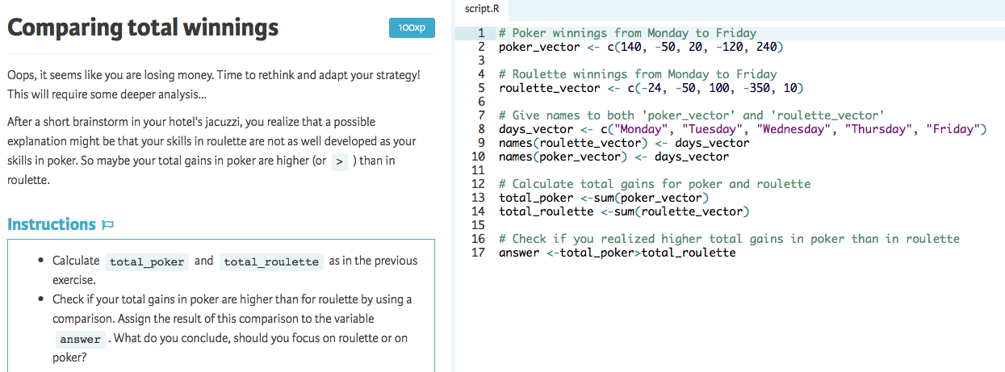

Slide 32
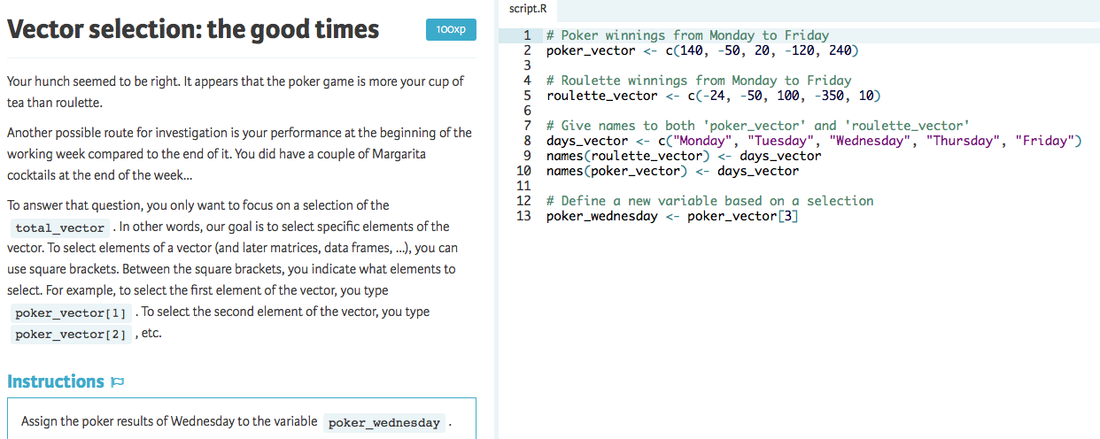

Slide 33
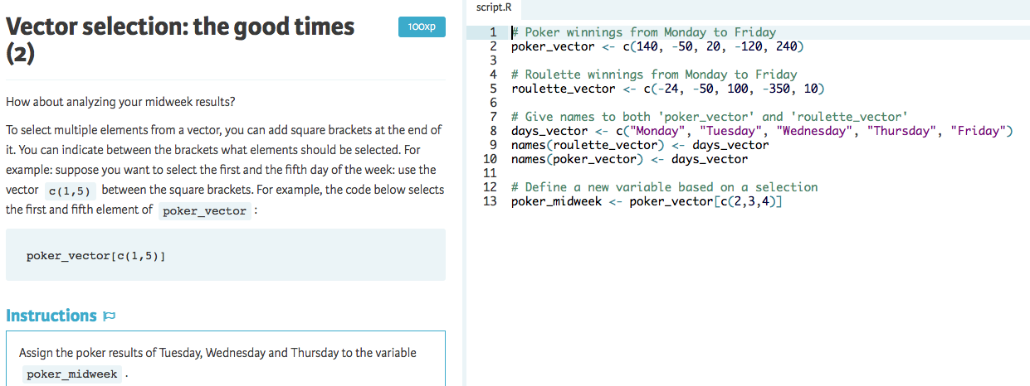

Slide 34
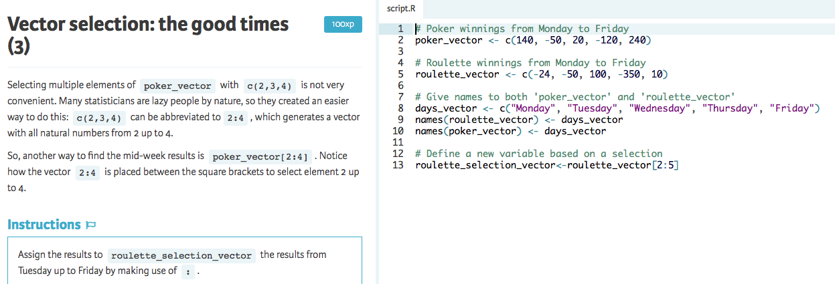

Slide 35
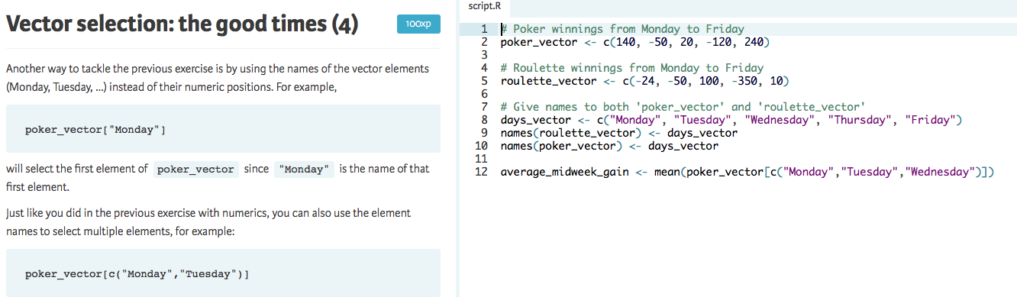

Slide 36
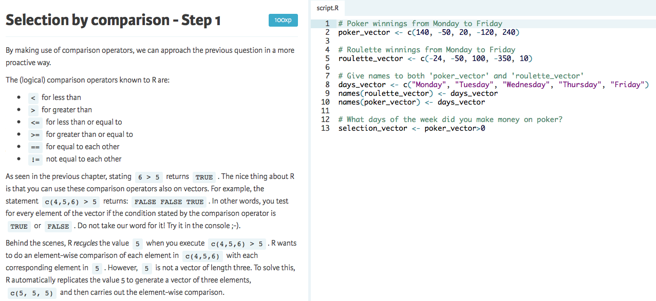

Slide 37
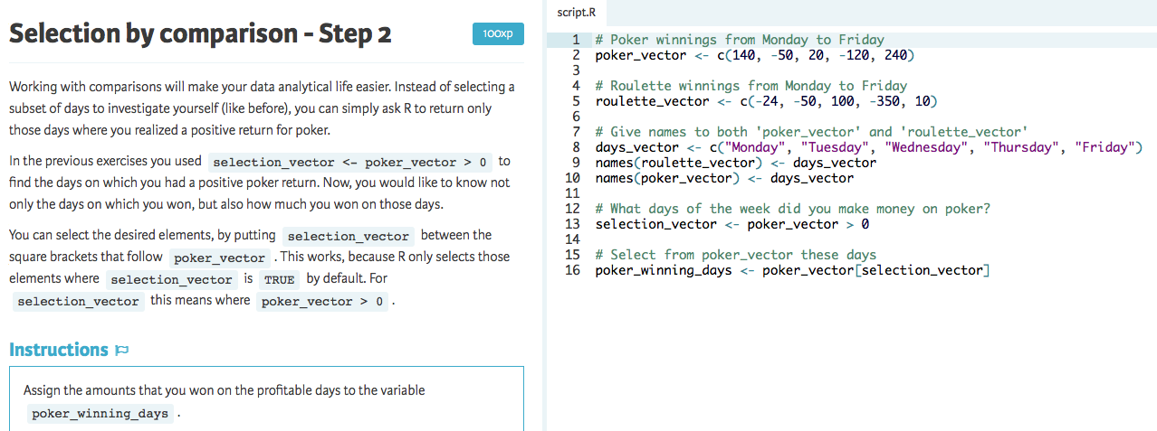

Slide 38
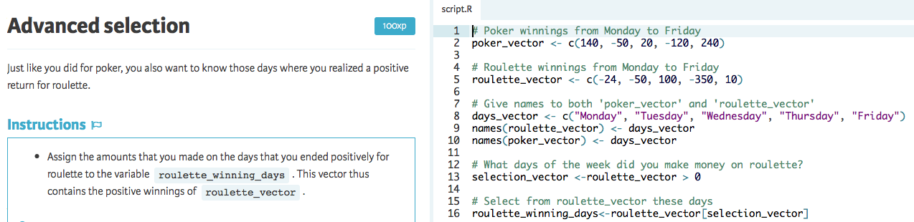

Slide 39
Matrices

Slide 40
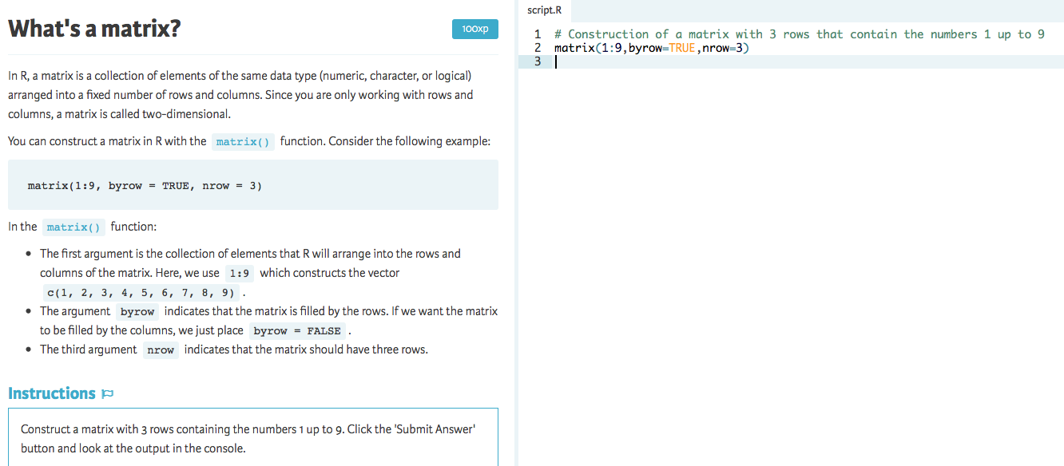

Slide 41
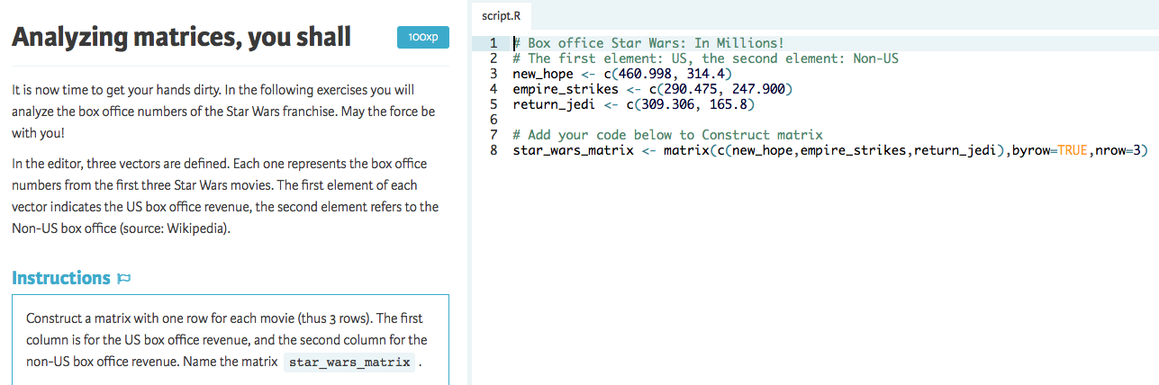

Slide 42
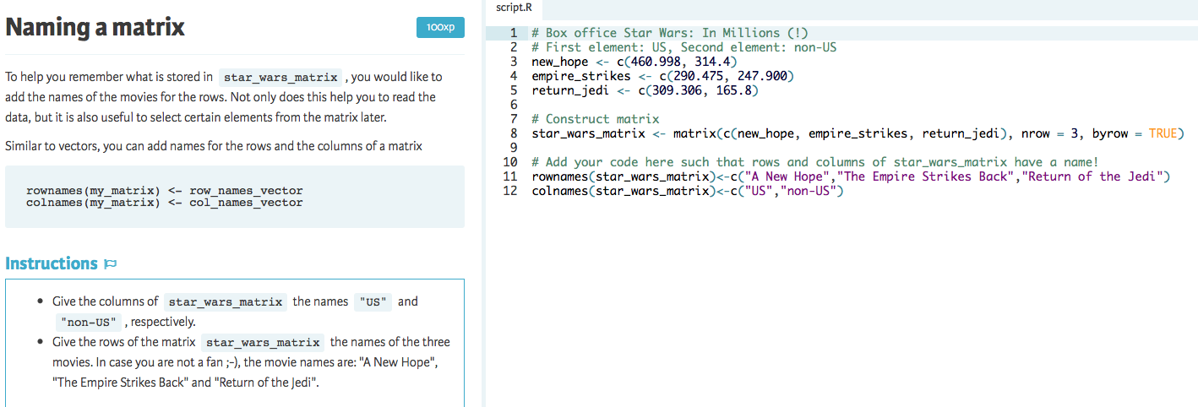

Slide 43
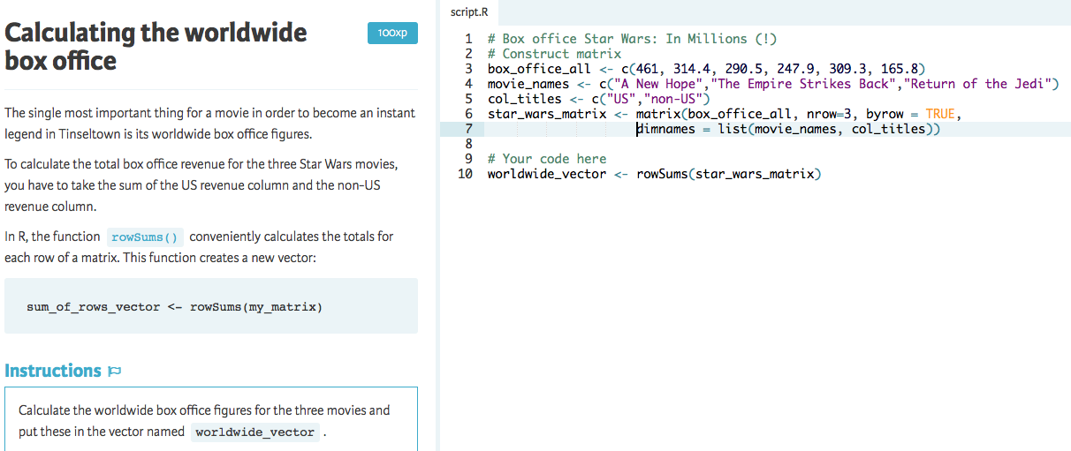

Slide 44
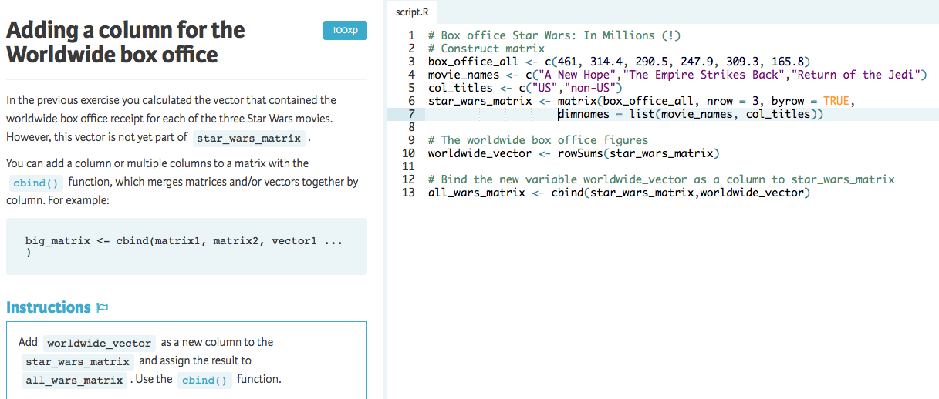

Slide 45
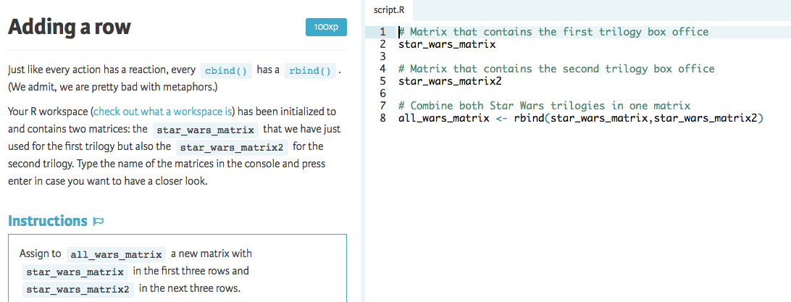

Slide 46
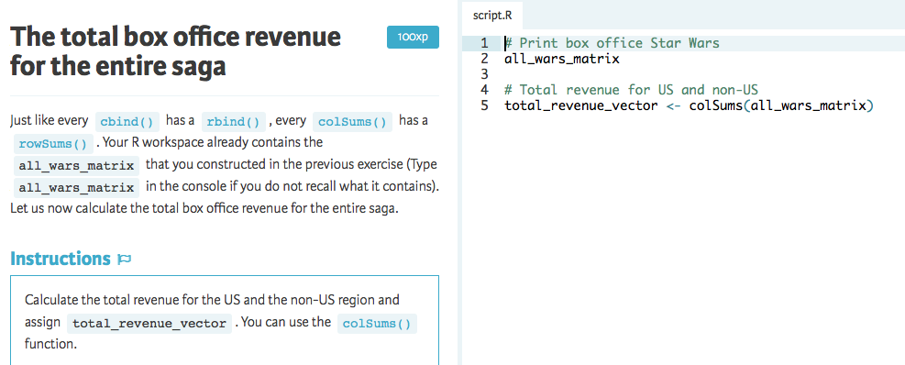

Slide 47
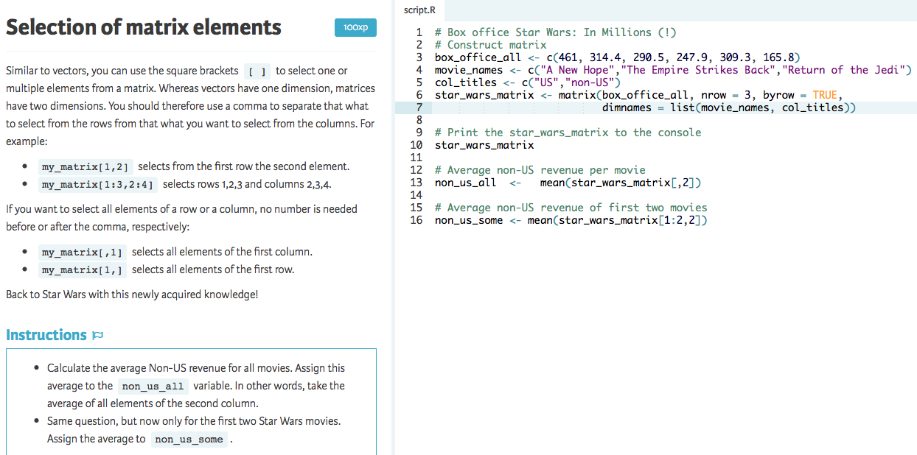

Slide 48
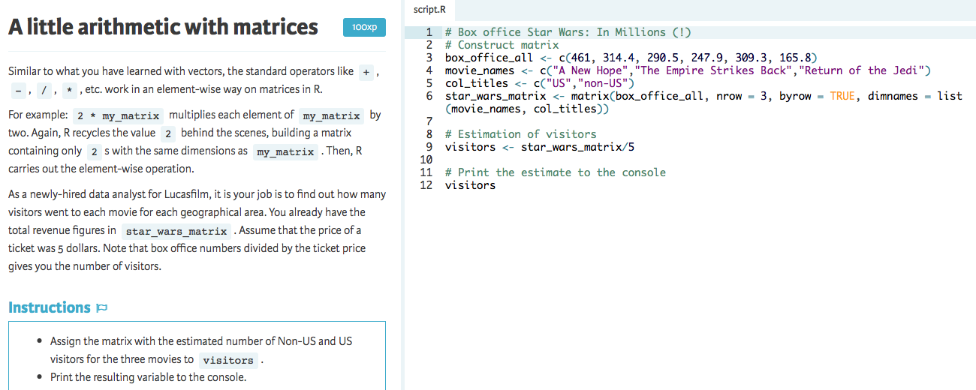

Slide 49
